Slide 1

25AIC115 Introduction to Cyber Physical Systems and Control Theory – 2
PROJECT TITLE:
“Mini Air Defence System”
GROUP 9:
Dhiren Vasudeva(CB.AI.U4CPS25014)
Pardhav Reddy(CB.AI.U4CPS25059)
Poovya.S(CB.AI.U4CPS25061)
Ch.Venkata Abhiram(CB.AI.U4CPS25012)
1

Slide 2
Contents of presentation
1. Introduction
2. Recap
3. Problem Statement
4. Objectives
5. System Architecture
6. Hardware Components Used
7. Software Tools Used
8. Methodology
8. Implementation Setup
9. Results & Observations
10. Applications, Limitations & Future Enhancements
11. Conclusion & Reference
2

Slide 3
Problem Statement
Traditional security systems either detect everything blindly (ultrasonic) or require constant human monitoring. There is a need for an intelligent, low-cost system that can identify specific threat objects, distinguish safe targets, and trigger a response automatically or on command — with remote notification capability.
3

Slide 4
Introduction
Mini Air Defence System is a smart detection and response system designed to identify specific objects and trigger an action.
Objective
Detect specific objects using computer vision
Improve previous ultrasonic-based detection system
Provide manual override shooting mechanism
Applications
Civilian security areas
Small military camps
Restricted zones
4

Slide 5
Real World Air Defence Systems
Modern air defence systems operate on similar principles but with advanced technology.
Examples include:
• Iron Dome (Israel) – intercepts short-range rockets
• Patriot Missile System (USA) – surface-to-air missile defense
• S-400 (Russia) – long-range air defense system
Our prototype demonstrates the basic working concept of these systems using low-cost components.
5

Slide 6
Previous Semester Work
System Components
Ultrasonic Sensor
Servo Motor
Microcontroller
Trigger Mechanism
Working
Detect object using ultrasonic distance
Rotate servo motor
Activate shooting mechanism
Limitations
Cannot identify objects
Detects all obstacles
Not intelligent detection
6

Slide 7
Improvements in Current Semester
New features added:
Camera module for vision
YOLOv11 object detection
Detection of specific objects:
Mobile Phone
ID Card
Water Bottle
Manual shoot button added
More accurate targeting system
Integration of Telegram
Included website
7

Slide 8
Literature Review
How Our Work Differs | Author / Year | Work Done | Gap Identified
We embed YOLOv8/v11 inside a closed-loop CPS with servo + Telegram alerts. | Redmon et al., 2016 | Introduced YOLO — a single-stage real-time object detection architecture. | Generic detector — no integration with physical actuators or alert systems.
We deploy YOLO on CPU + Arduino | Sohan et al., 2024 | Reviewed YOLOv8 — benchmarked accuracy and speed against v5/v7. | Survey only; no deployment on resource-constrained edge hardware.
We add servo-aimed response + manual override for active defense. | Springer, 2024 | YOLOv8 smart surveillance CCTV system, reporting 96% detection accuracy. | Passive monitoring only — no physical response or actuation layer.
Our YOLO layer classifies targets and ignores persons (green/red logic). | IJSAT, 2025 | Survey of Arduino-based defense radars using ultrasonic + servo turrets. | Ultrasonic detects all obstacles — cannot classify threat vs. safe object.
8

Slide 9
SOFTWARE TOOLS USED
Simulink
Python
YOLOv11 Object Detection
OpenCV
Embedded Control Programming
Processing
Dataset Used
Custom dataset trained for:
Phone
ID card
Water bottle
9

Slide 10
HARDWARE COMPONENTS USED
Camera Module
Microcontroller (Arduino)
Servo Motor
Ultrasonic Sensor
Power Supply
10

Slide 11
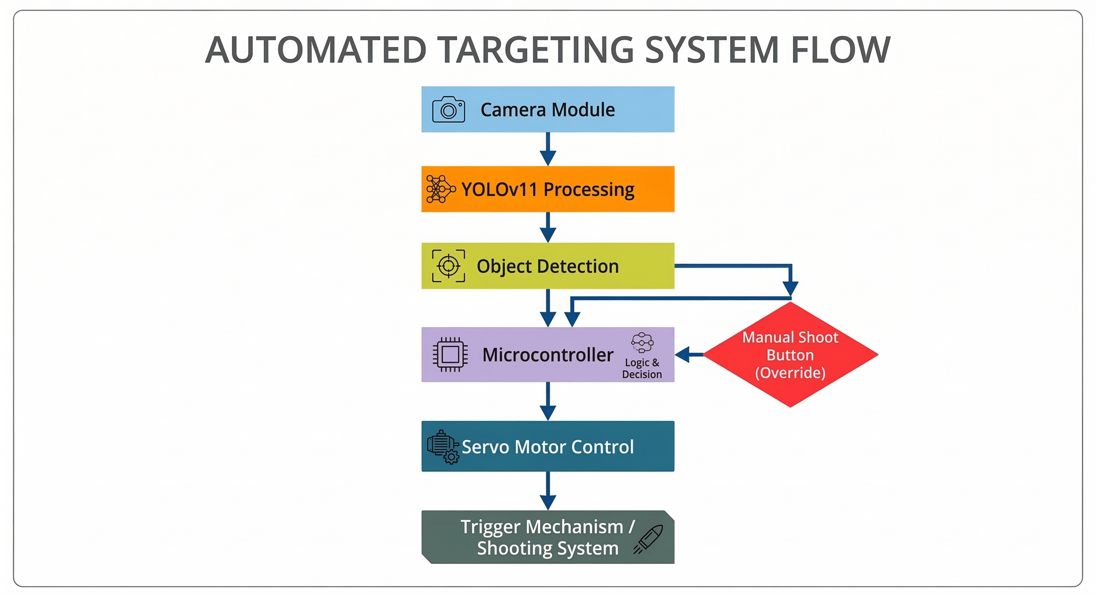
System Architecture
11

Slide 12
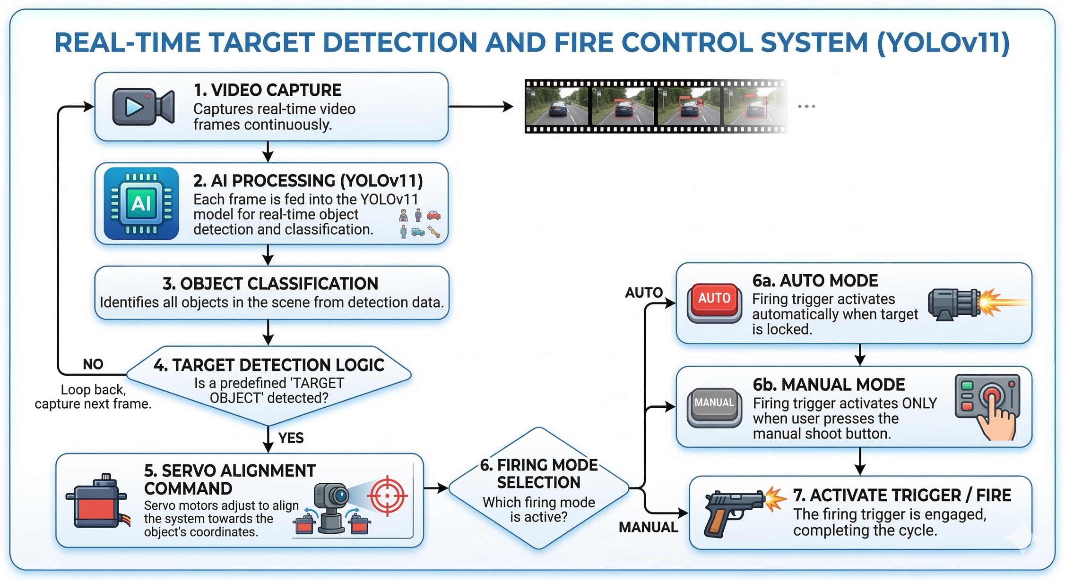



12

Slide 13
Working Methodology
The proposed system operates through a combination of computer vision, sensor detection, and mechanical actuation. The overall working process is explained in the following steps.
1. Object Monitoring
The camera module continuously captures real-time video of the surrounding area. The video frames are sent to the processing unit for analysis.
2. Image Processing
Each frame from the camera is processed using YOLOv11 object detection algorithm. The model analyzes the image and identifies objects present in the frame.
3. Object Detection and Classification
The YOLOv11 model detects and classifies only the trained objects, which include:
Mobile Phone
ID Card
Water Bottle
When any of these objects are detected, the system highlights them with bounding boxes and identifies their position in the frame.
13

Slide 14
Working Methodology
4. Target Position Identification
After detection, the coordinates of the detected object are obtained from the model output. These coordinates are used to determine the direction in which the system must move to align with the object.
5. Servo Motor Control
The detected target position is sent to the microcontroller, which controls the servo motor. The servo motor rotates to align the shooting mechanism toward the detected object.
6. Manual/Auto Shooting Mechanism
Once the target is aligned, the system waits for user confirmation if in manual mode.
A manual shoot button is provided, and when pressed, it activates the trigger mechanism to perform the shooting action. Else in auto mode it fires immediately after detecting the target without any delay.
14

Slide 15
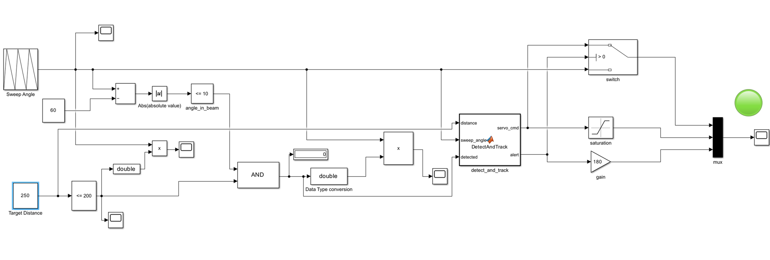
Simulink- Object out of range
15

Slide 16
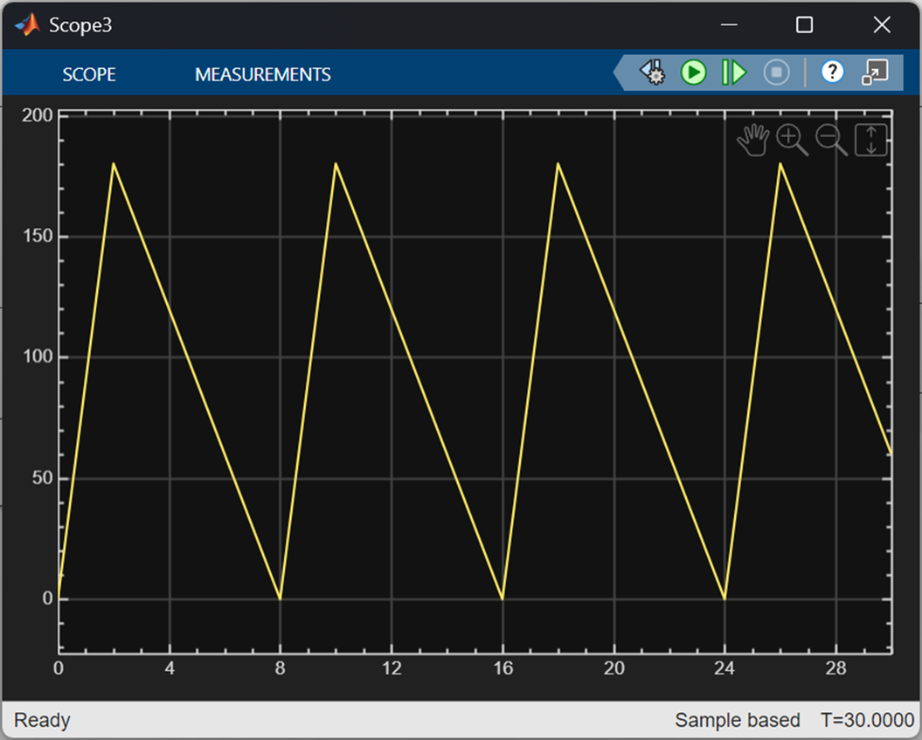
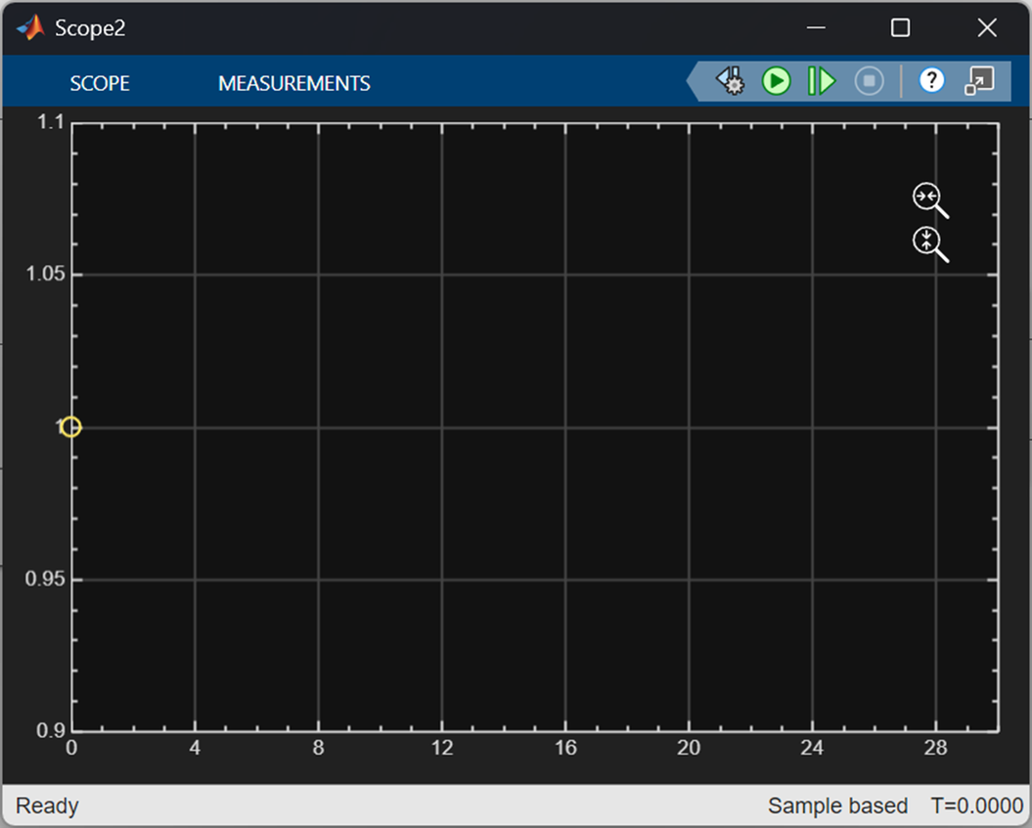
OBSERVATIONS
16

Slide 17
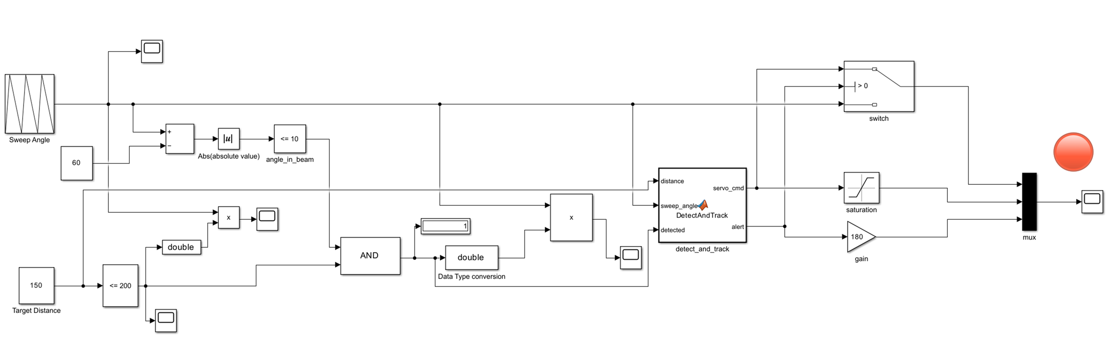
Simulink Object in range
17

Slide 18
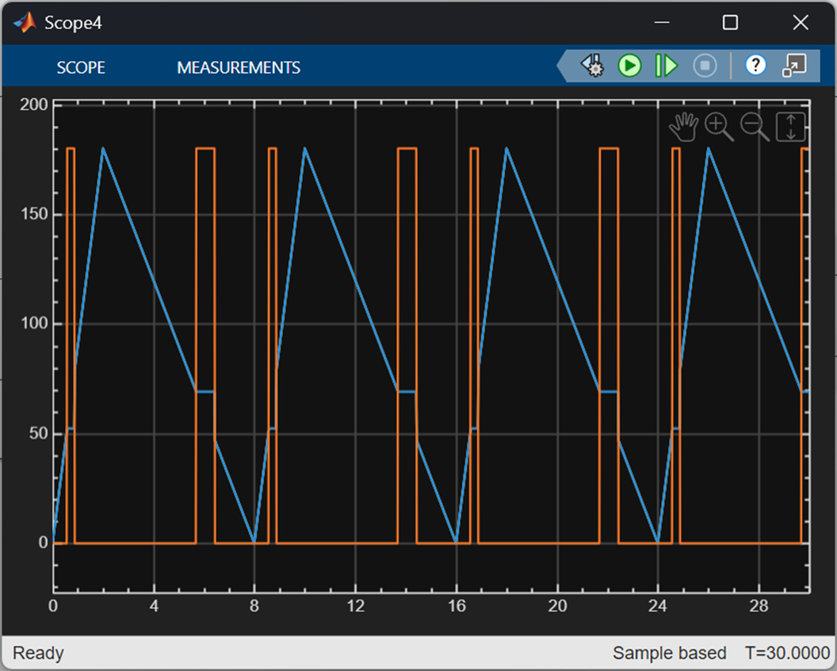
OBSERVATIONS
18

Slide 19
Remote Monitoring via Telegram Bot
What it does:
On confirmed target fire → sends instant Telegram message with timestamp
Automatically captures and sends a .jpg photo of the target
Enables remote operator awareness even when away from the system
How it works (from your code):
TARGET DETECTED → FIRE CONFIRMED
↓
save target_{timestamp}.jpg
↓
POST /sendMessage → "🚨 TARGET ELIMINATED"
POST /sendPhoto → Target image attached
Why it matters: Adds a real cyber-physical systems layer — physical event triggers digital notification, closing the CPS feedback loop your course focuses on.
19

Slide 20
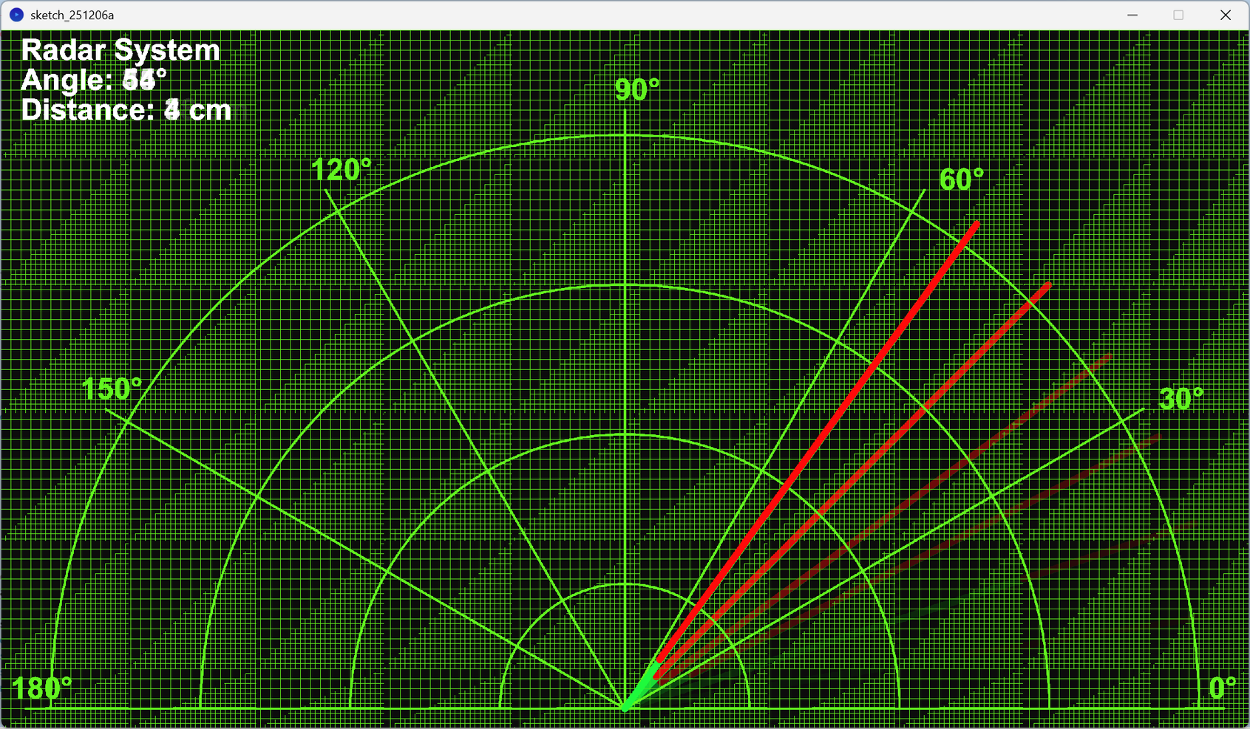
RADAR
20

Slide 21
Results
System successfully detects:
Mobile Phones
ID Cards
Water Bottles
Advantages
More accurate than ultrasonic-only system
Vision-based detection
User controlled firing
21

Slide 22
Limitations & Future Enhancements
Limitations:
Detection accuracy drops in low-light or occluded conditions
YOLO runs on CPU — causes latency (~200-400ms per frame)
Fixed camera FOV limits detection range
System depends on USB serial; wireless control not yet implemented
Custom-trained model (best.pt) still needs more training data for ID cards
Future Enhancements:
GPU acceleration (your gpu.py already checks for CUDA — wire it in!)
Pan-tilt dual-axis servo for full 2D tracking
Upgrade to custom-trained YOLOv11 model replacing COCO classes
Add night-vision / IR camera support
Expand Telegram integration to include live video stream alerts
22

Slide 23
Conclusion
The proposed system integrates YOLOv11-based object detection with a camera module and servo control to create an improved smart detection mechanism. The system successfully identifies specific objects such as mobile phones, ID cards, and water bottles in real time. Compared to the previous ultrasonic-only system, this approach provides more accurate and intelligent detection. The addition of a manual shoot button ensures better control and safety during operation. Overall, the project demonstrates the effectiveness of combining AI-based vision systems with embedded hardware for security applications.
23

Slide 24
THANK YOU
24

